Slide 1
Specimen-based modeling, stopping rules, and the extinction of the the ivory-billed woodpecker Campephilus principalis
Nicholas J. Gotelli
Department of Biology
University of Vermont
Burlington VT 05405

Slide 2

Rob Colwell
University of Connecticut
Anne Chao
National Tsing Hua University
Gary Graves
Smithsonian Institution

Slide 3
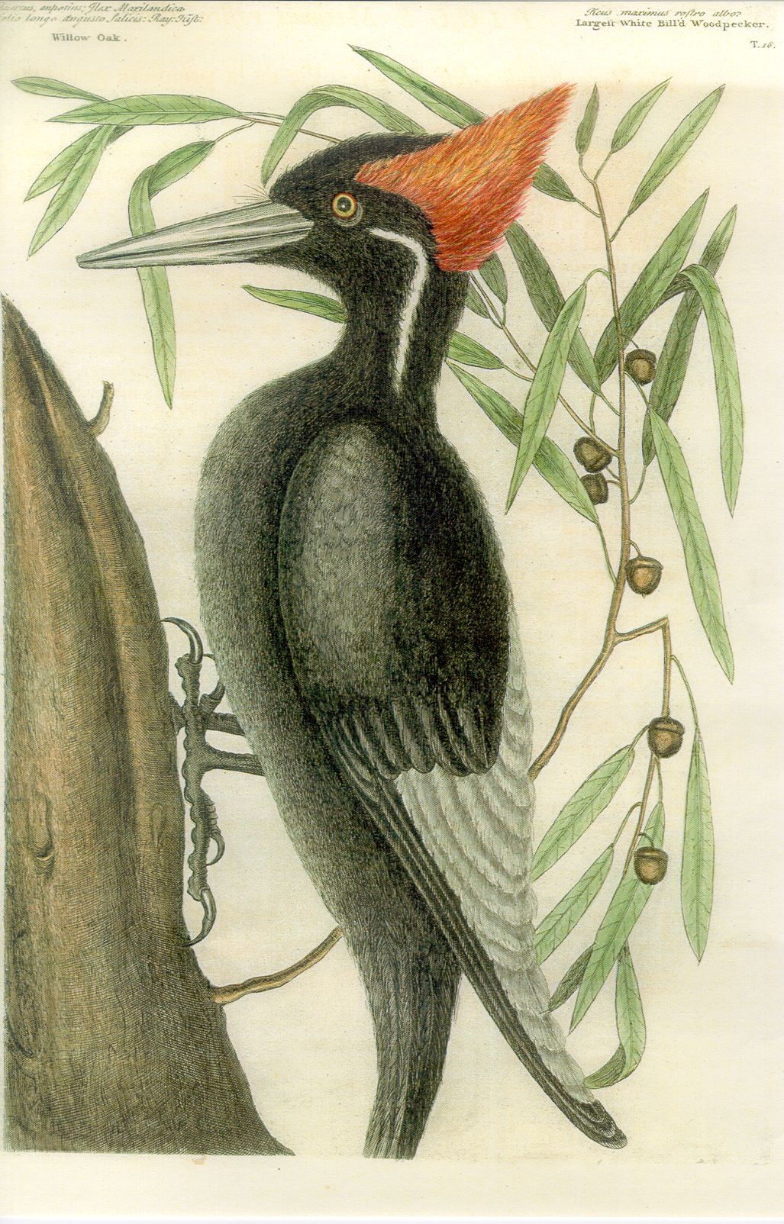

Slide 4
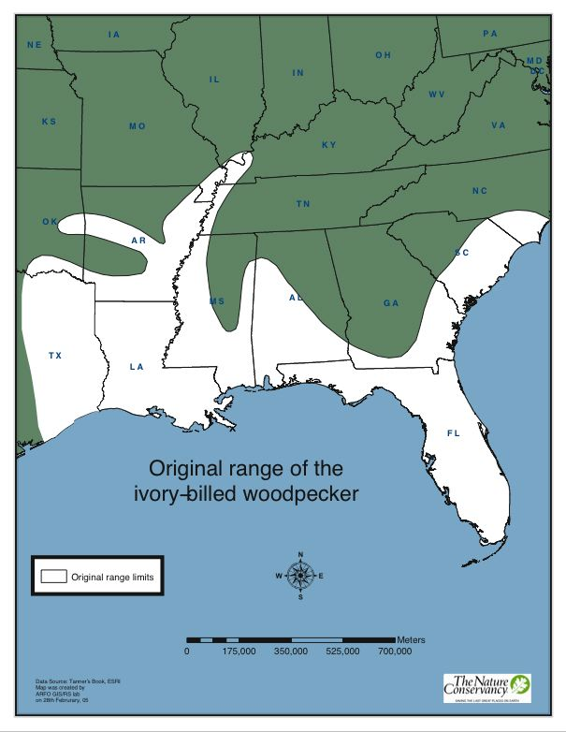

Slide 5
Decline & Extinction of Ivory-billed Woodpecker
~1900 “common”
1932 last specimen collected
1944 last confirmed sighting

Slide 6

Causes of Ivory-billed Extinction
Hunting
Trophy collecting
Habitat Loss
(Scientific Collecting)

Slide 8
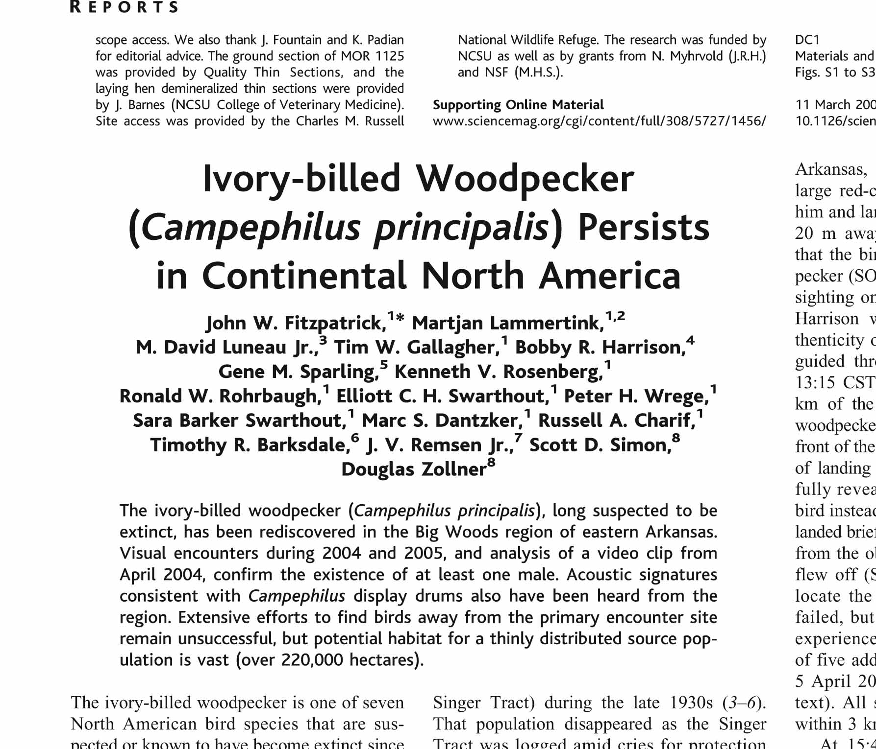

Slide 9
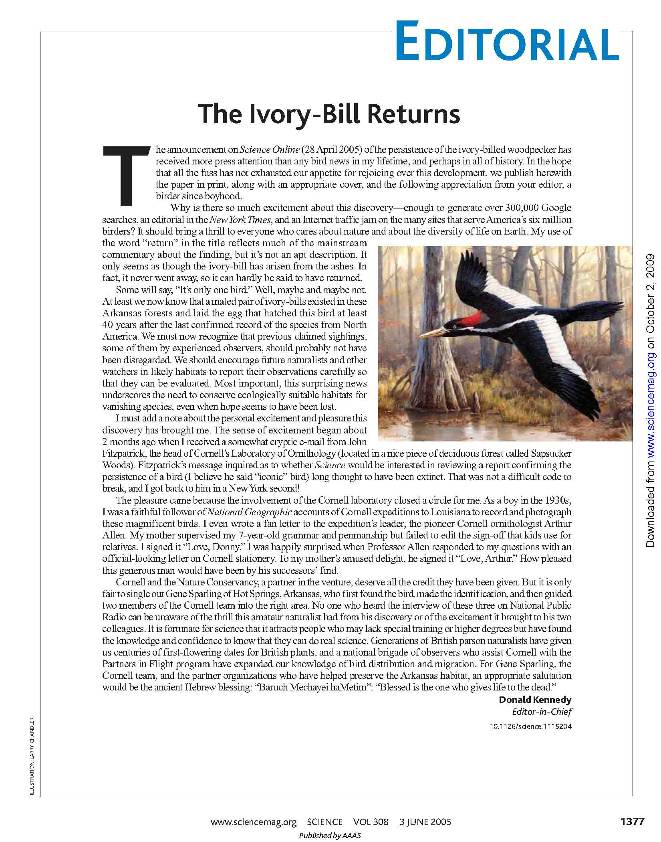

Slide 10
“I must add a note about the personal excitement and pleasure this discovery
has brought me....Blessed is the one who gives life to the dead.”
Donald Kennedy, Editor, Science
“We have dedicated our time and our dreams to protecting and conserving this area. These woods are my church.“
John Fitzpatrick, Director, Lab of Ornithology, Cornell University
“It's like a funeral shroud has been pulled back, giving us a brief glimpse of a
living bird, rising Lazarus-like from the grave. “
Tim Gallagher, Editor, Living Bird, Cornell Lab of Ornithology

Slide 11
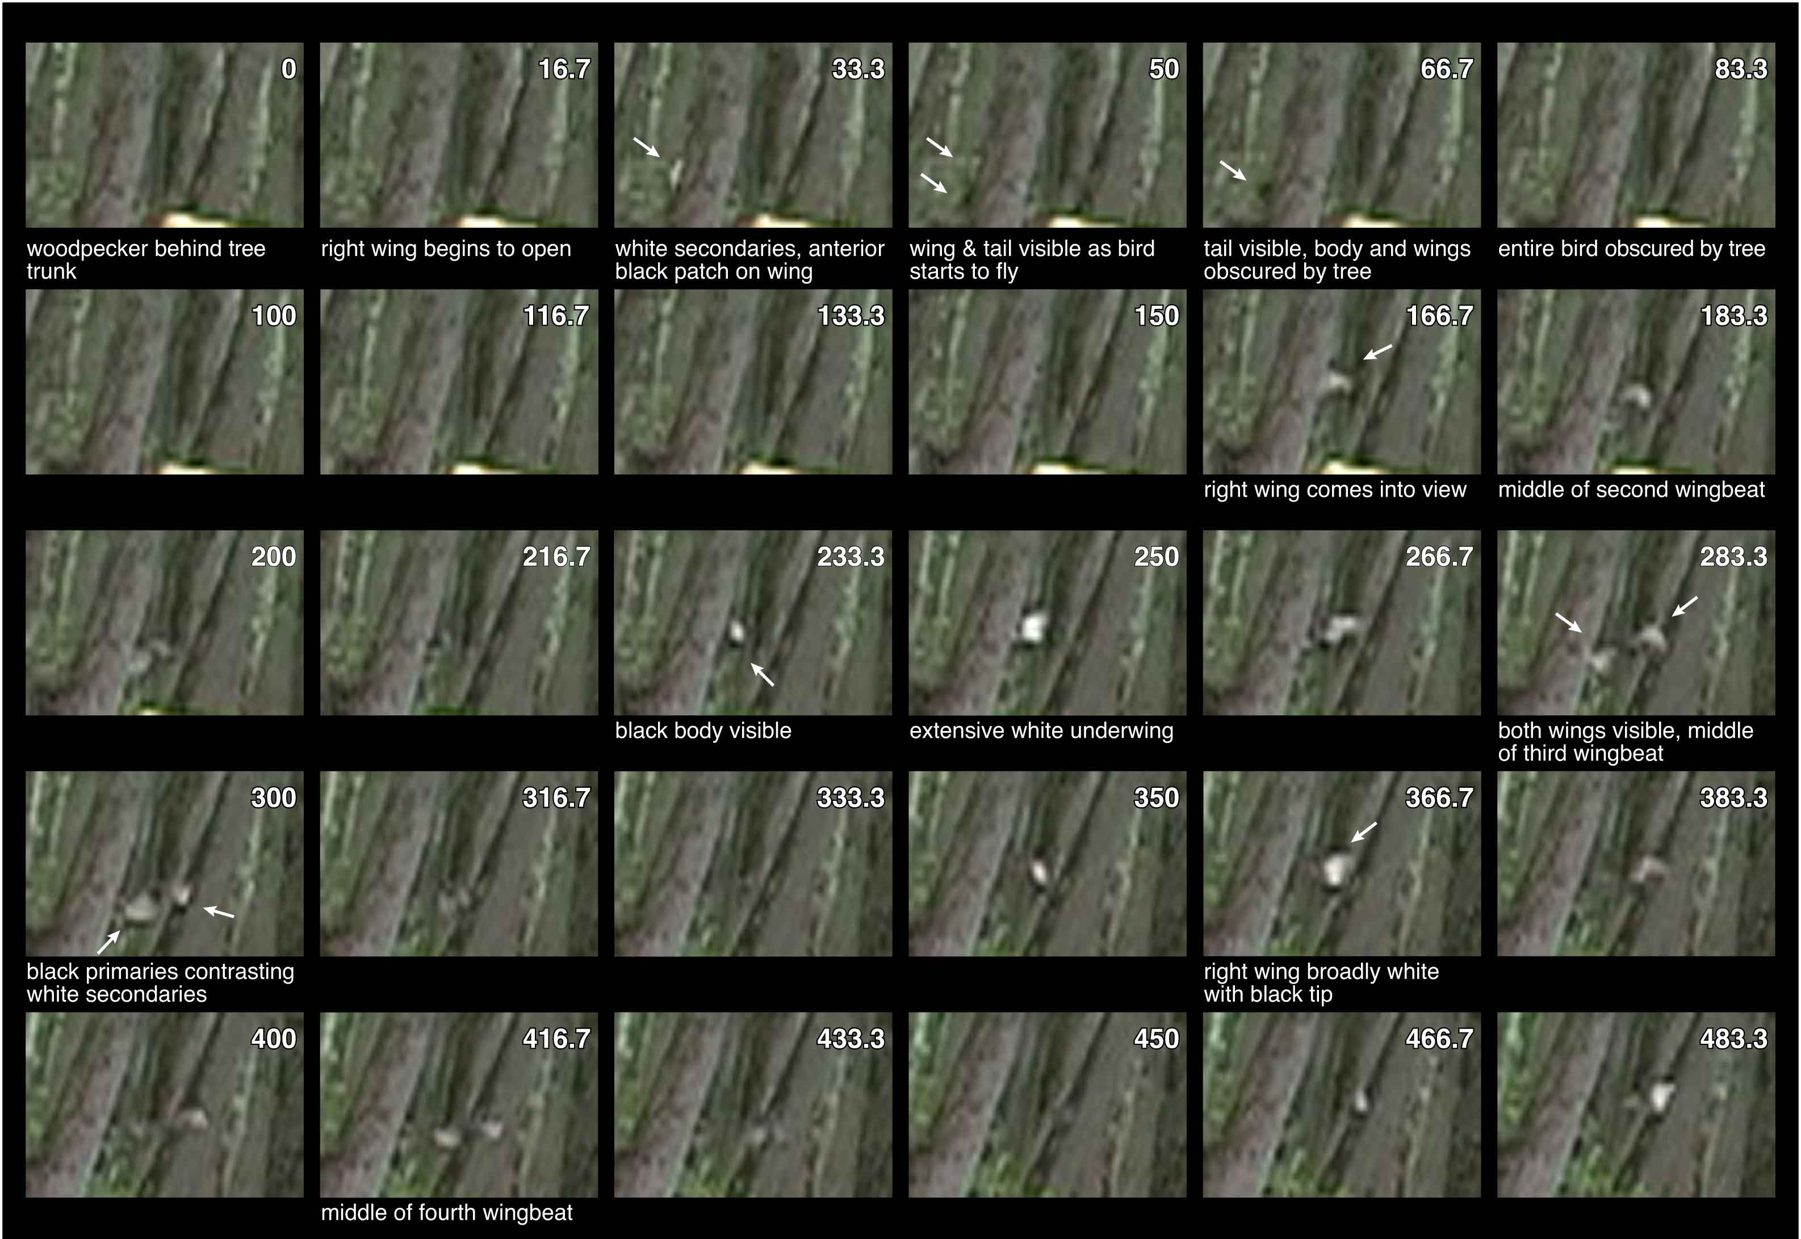

Slide 12
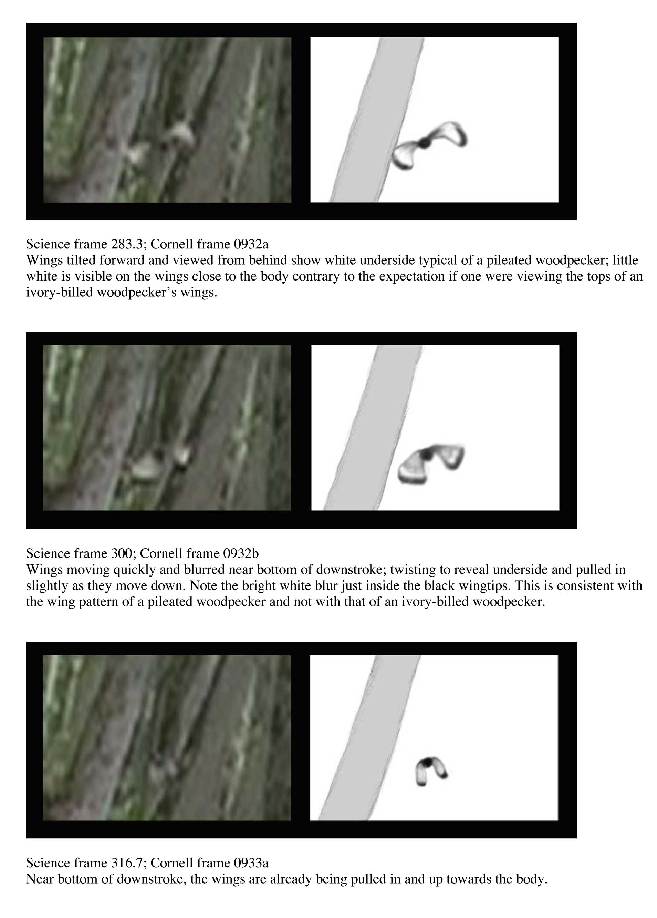

Slide 13
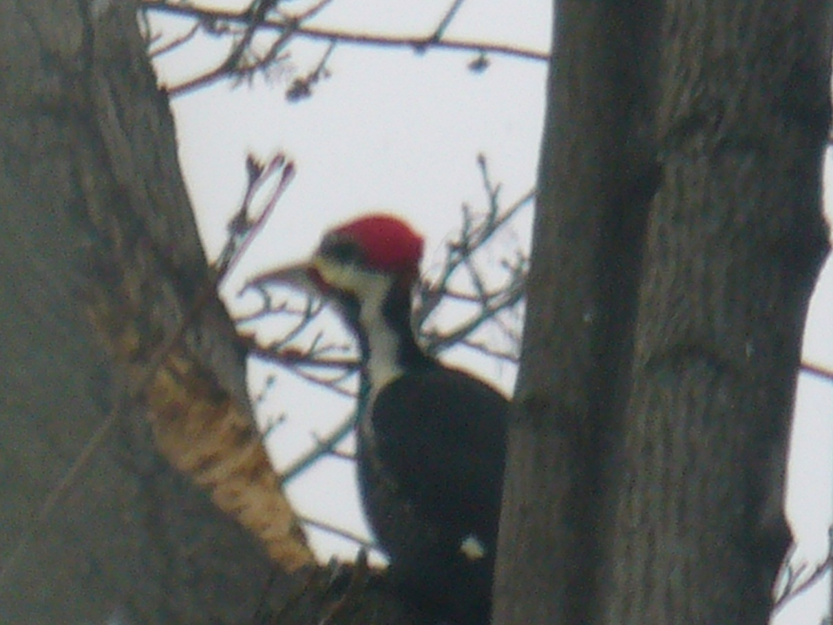
Burlington, VT 24 December 2008
Dryocopus pileatus (Pileated woodpecker)

Slide 14
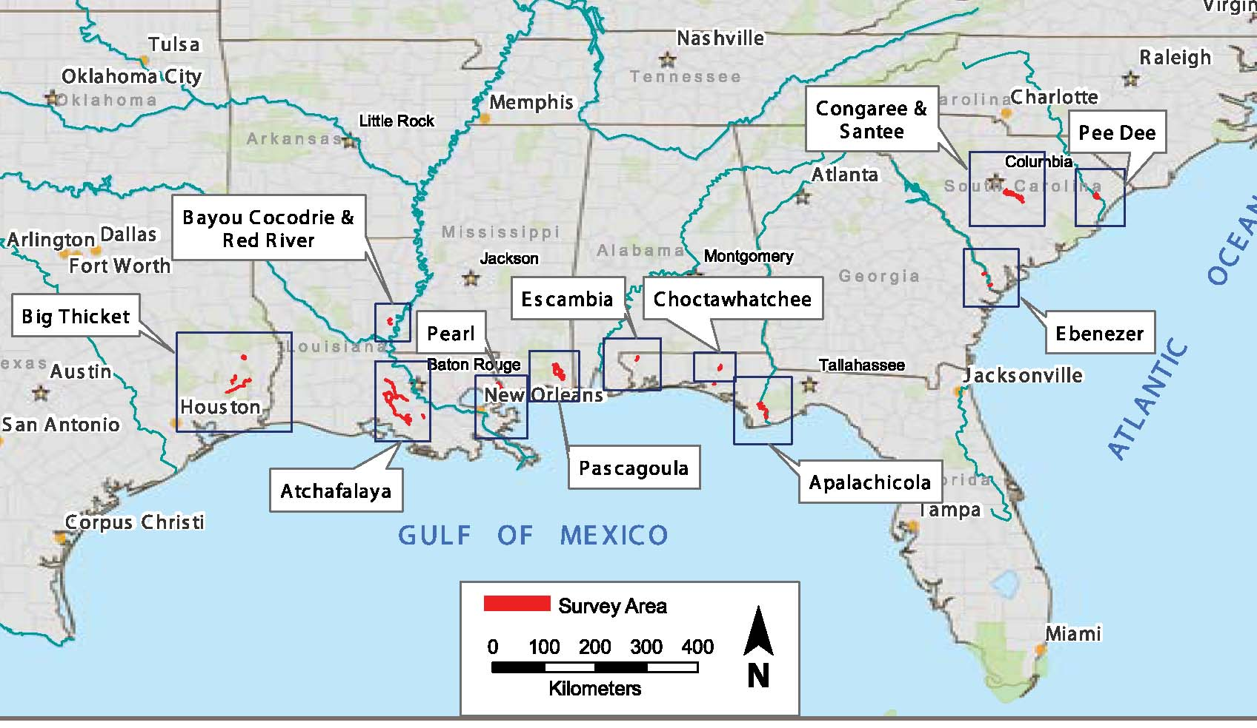

Slide 15


Slide 16

What is the probability that the ivory-billed woodpecker persists today?

Slide 17
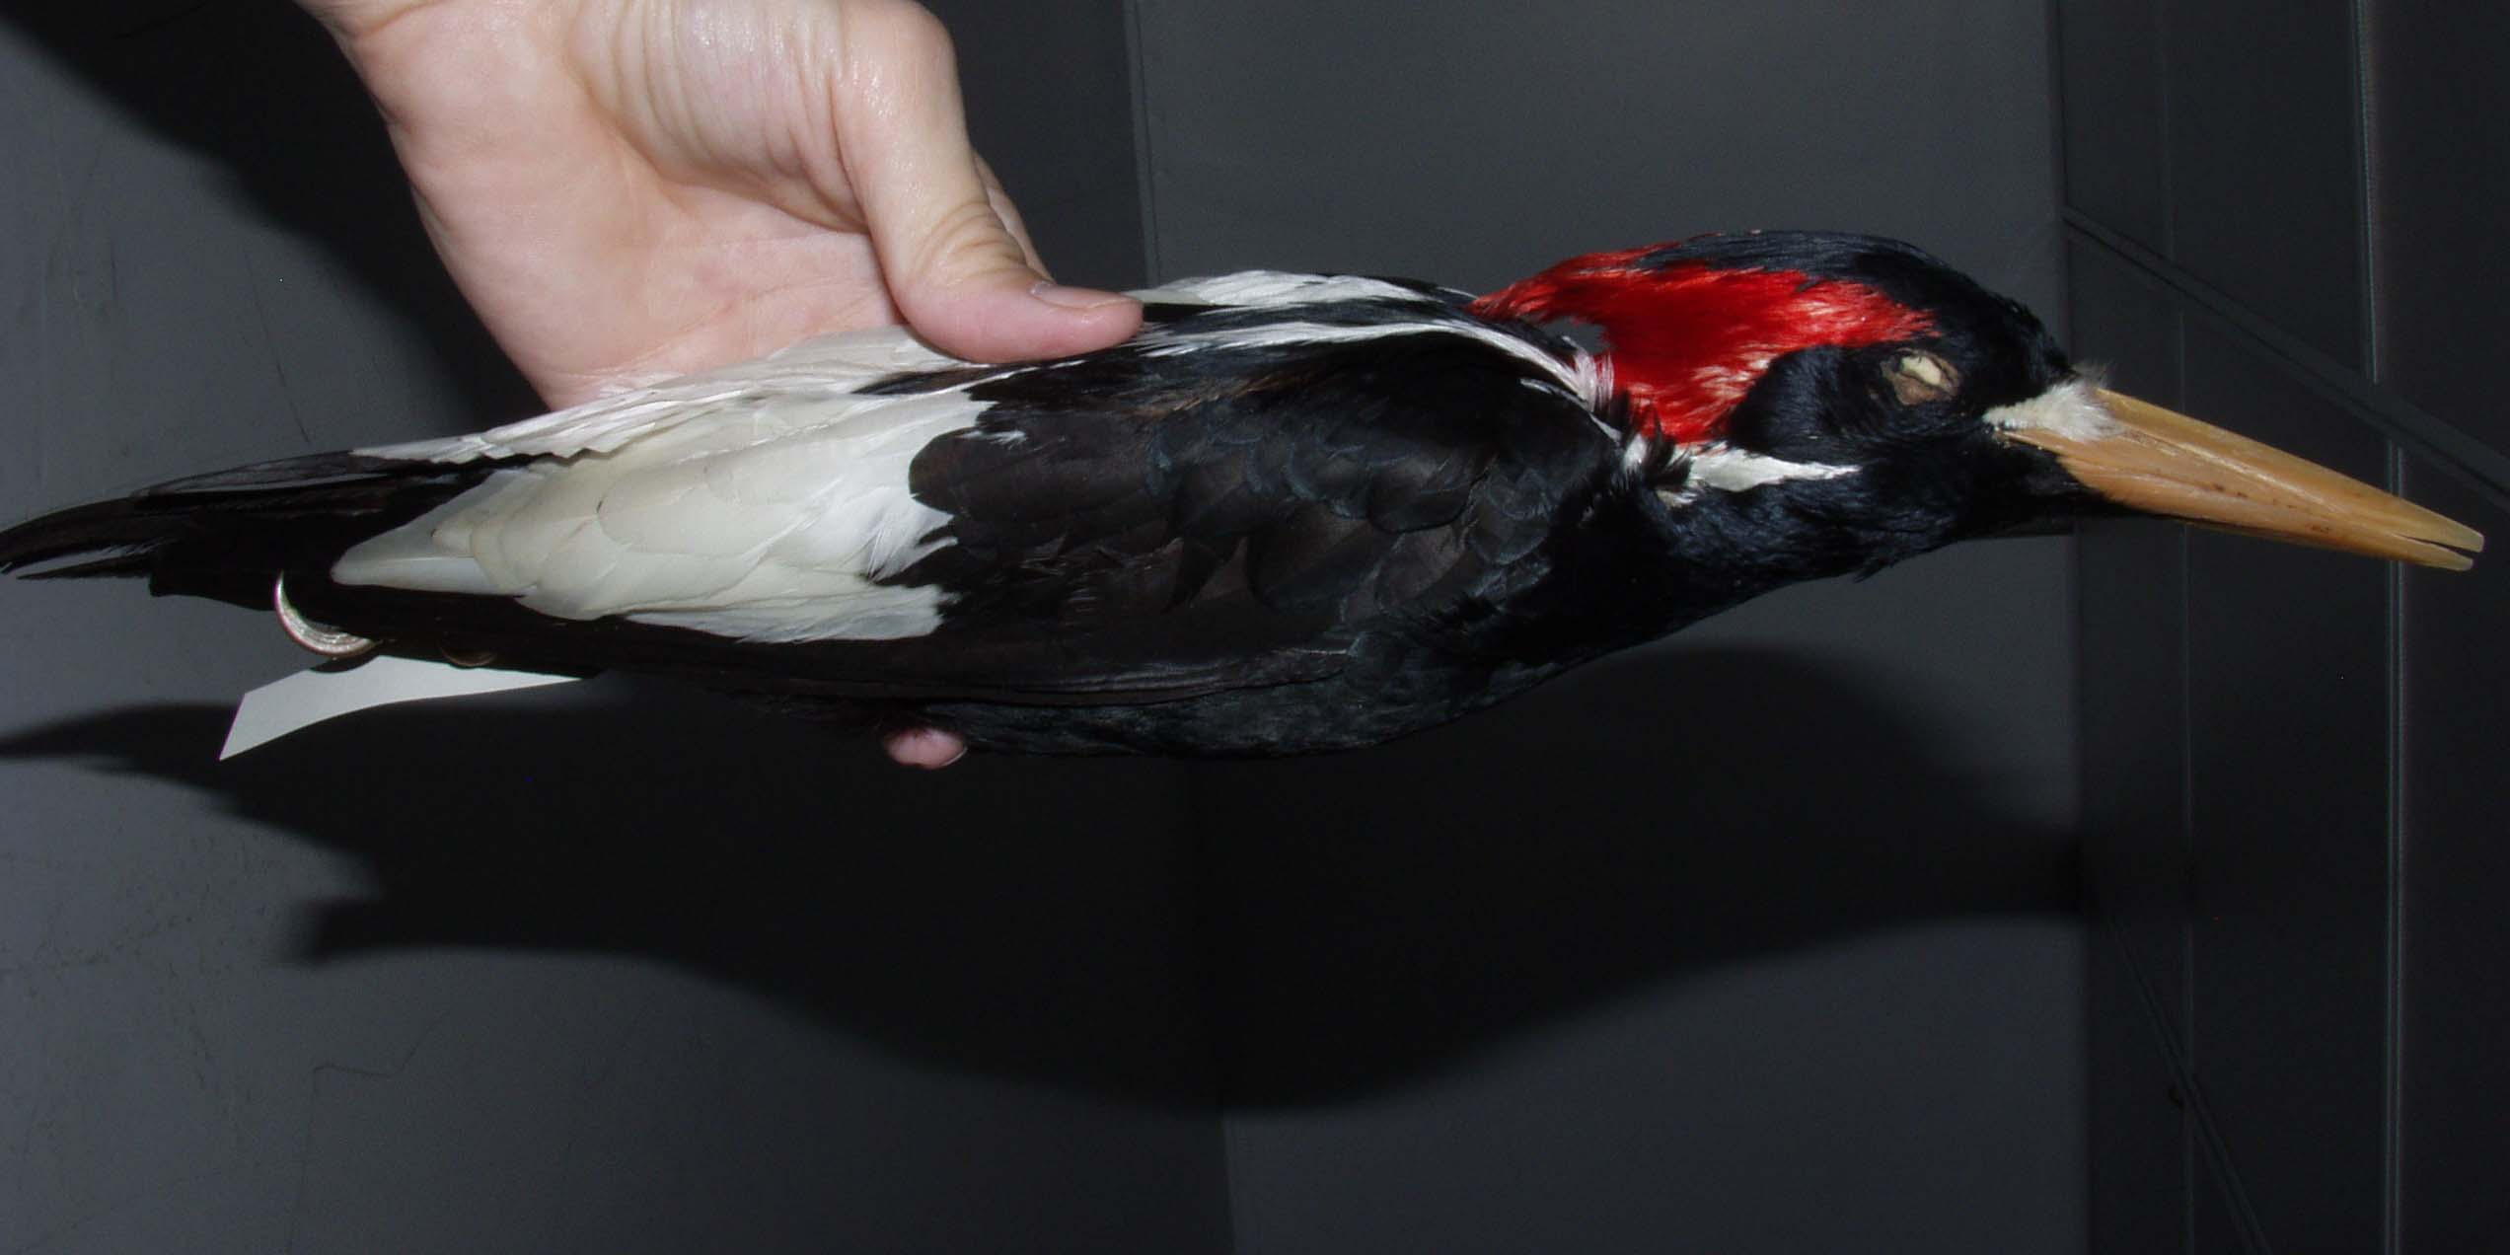
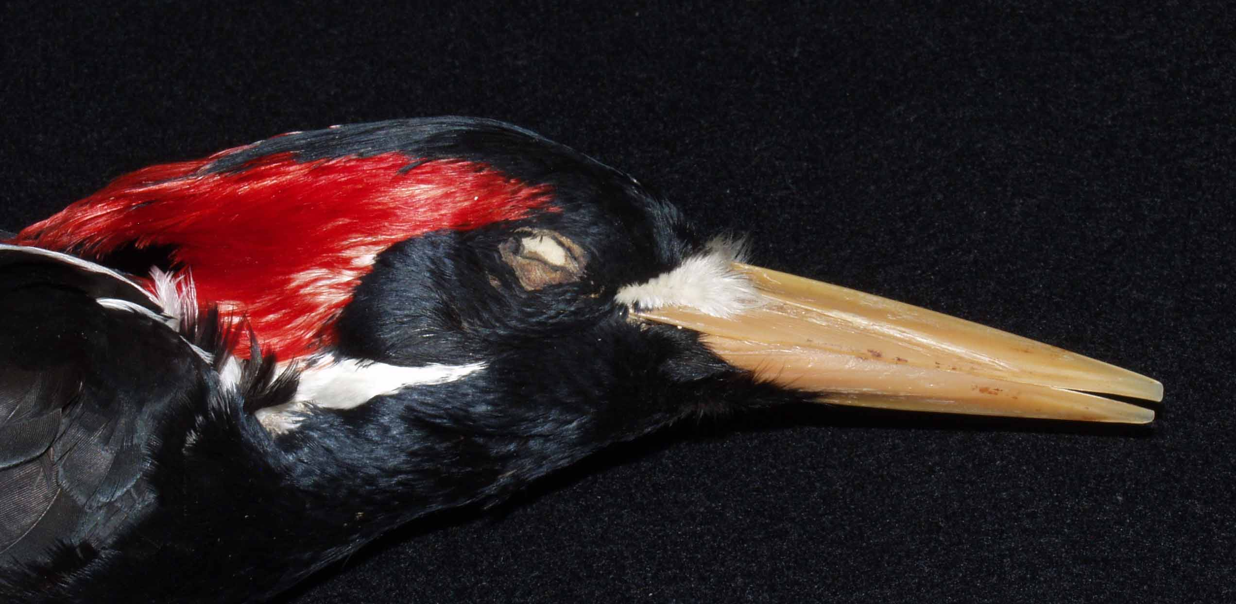
Dated, georeferenced museum specimens (1850-1932)
(N = 239 specimens)

Slide 18
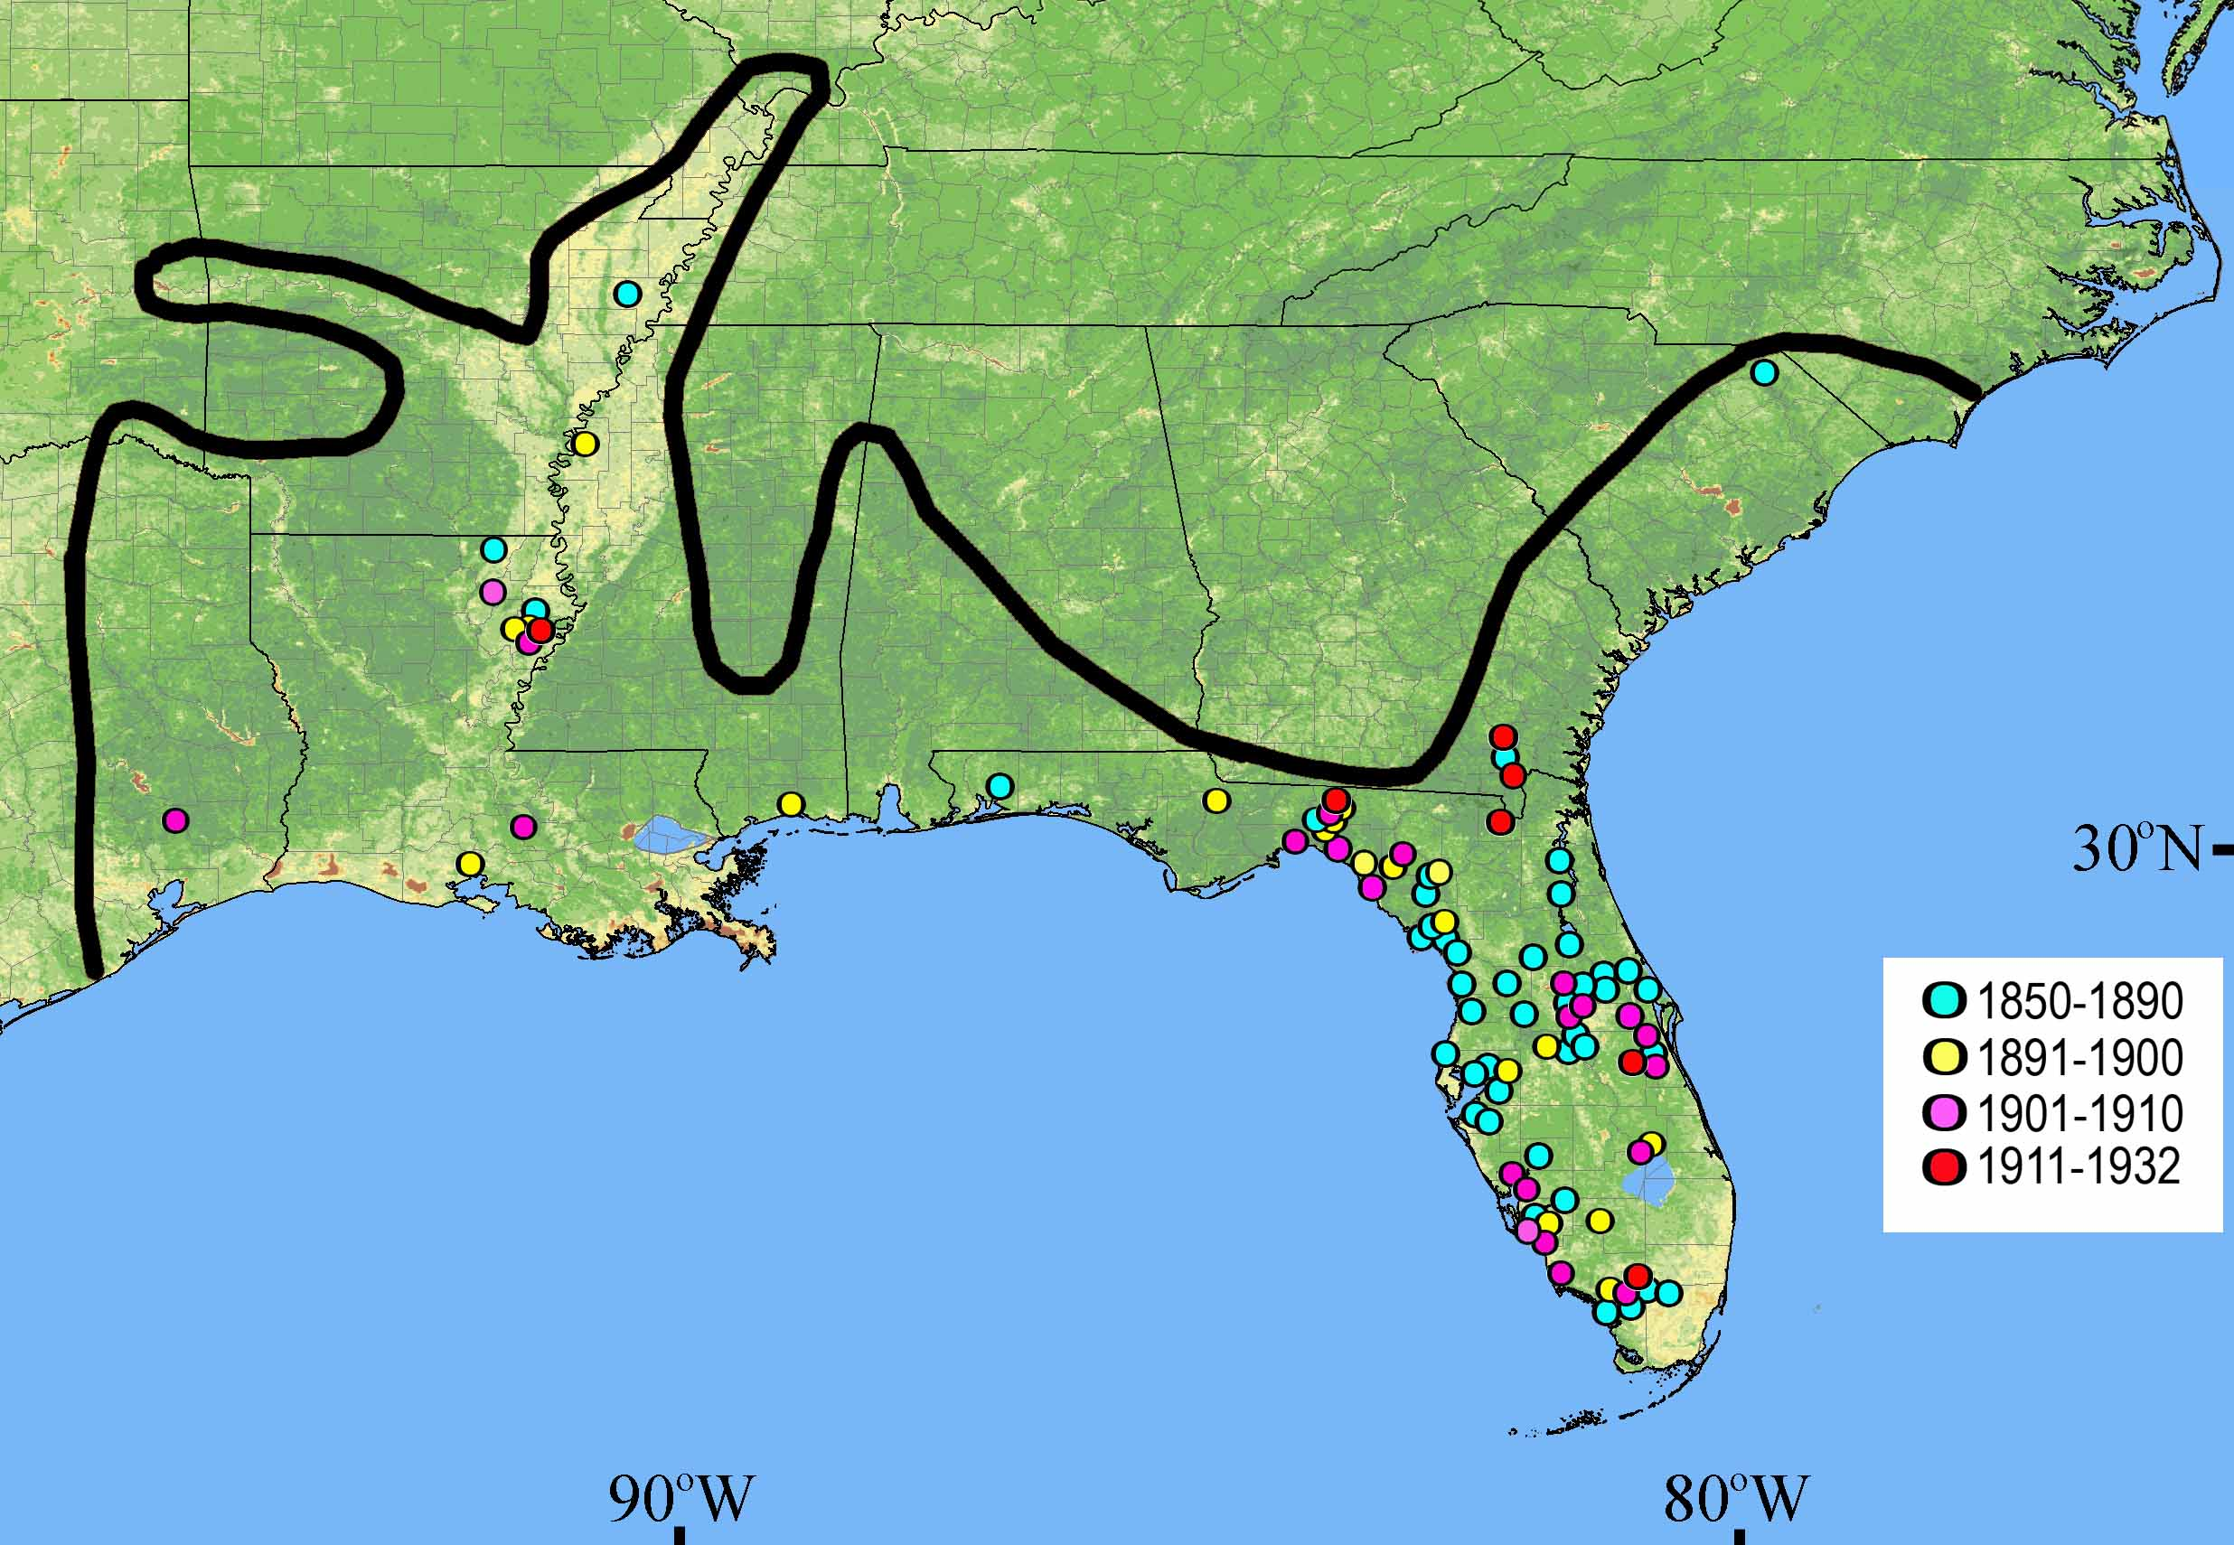

Slide 19
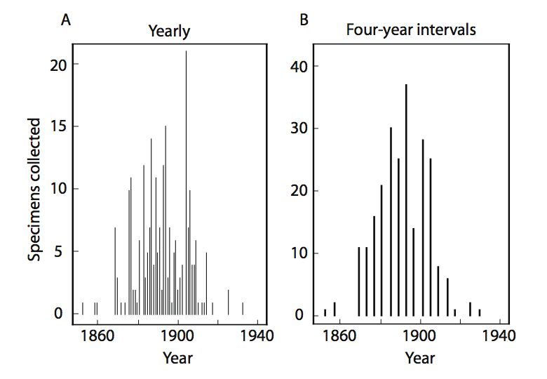

Slide 20
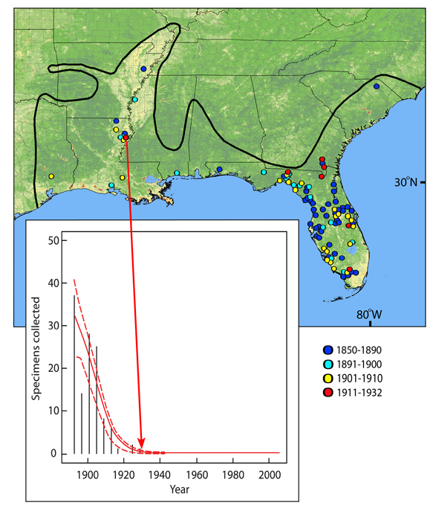

Slide 21
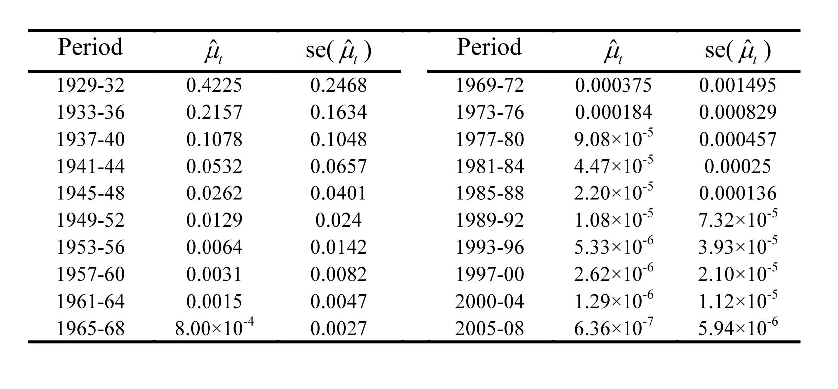

Slide 22
Model Formulation
Last single individual collected in 1932
Assume that 1/N = proportion of population represented by that individual
p = 1/N = probability of a single individual being collected as a specimen

Slide 23
Model Formulation
Last single individual collected in 1932
Assume that 1/N = proportion of population represented by that individual
p = 1/N = probability of a single individual being collected as a specimen
Population size at any future time n(t) can be estimated as:
n(t) = u(t)/p ≈ u(t)N
Probability of persistence = 1 – exp-(n(t))
[= non-negative portion of Poisson distribution]

Slide 24
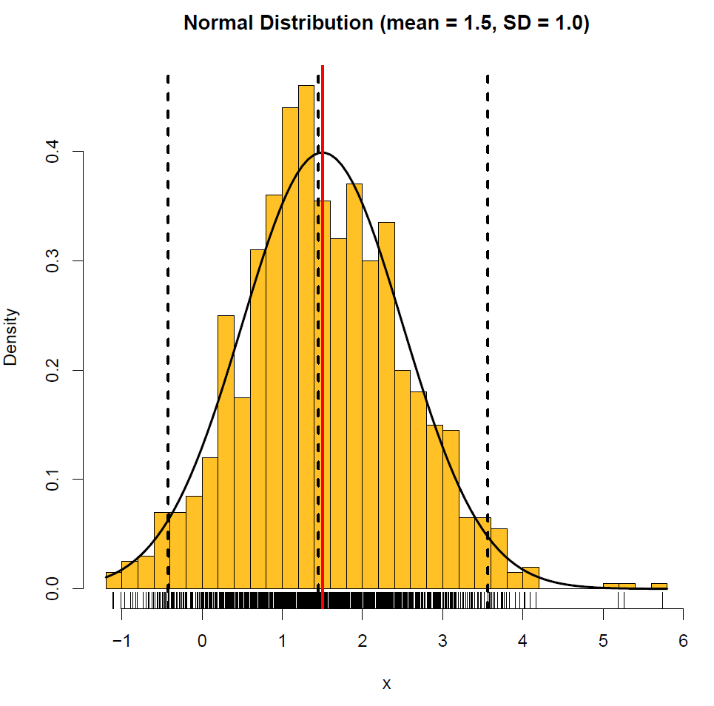
Continuous
Symmetric
Unbounded

Slide 25
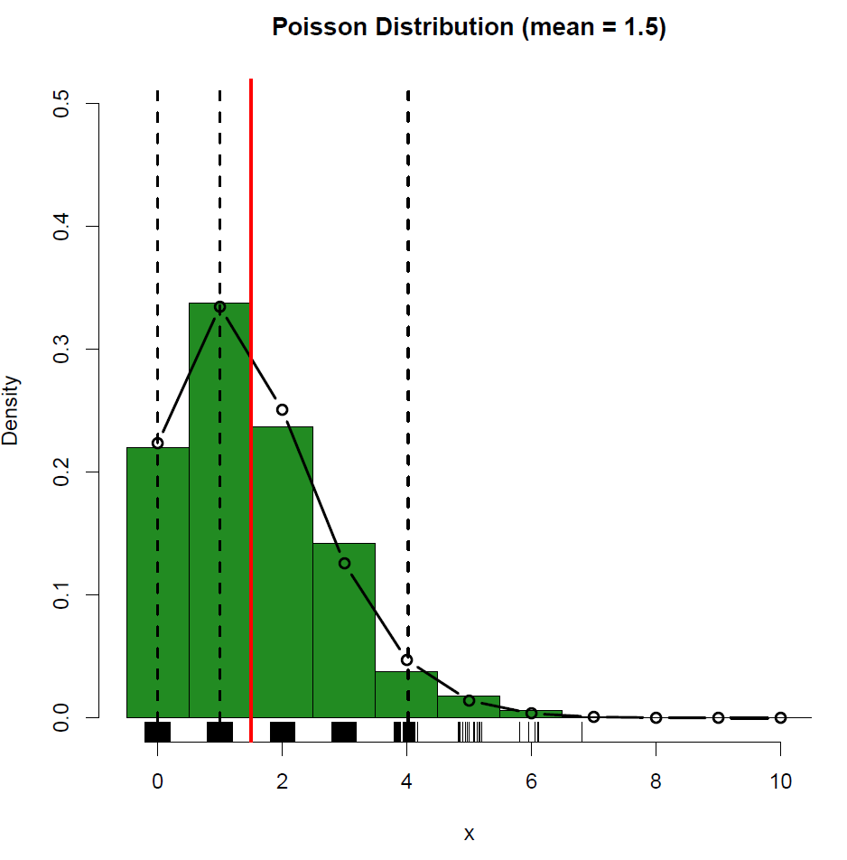
Discrete
Asymmetric
Bounded
P(extinction)
= 0.22

Slide 26
Model Assumptions
Declining collection curve of museum specimens mirrors overall population decline of IBW
Per individual probability of capture as a museum specimen (= p) is constant
Population size n(t) at time t is a stochastic realization of a Poisson process
Population size in 1932 (=N) is known or inferred

Slide 27
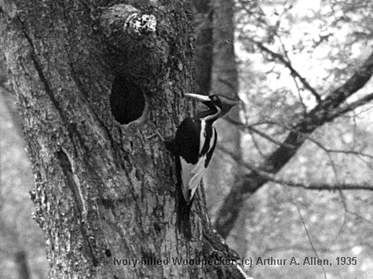
Benchmark Test of Model
Undisputed
photographic records
1933-1944

Slide 28
Benchmark Test with Photo Records
Assumed N in 1932 | u(t) in 1944 (extrapolated) | p = 1/N | n(t) = u(t)/p | P(persistence in 1944)
100 | 0.0532 | 0.01 | 5.32 | 0.995
20 | 0.0532 | 0.05 | 1.064 | 0.665

Slide 29
Benchmark Test with Photo Records
Assumed N in 1932 | u(t) in 1944 (extrapolated) | p = 1/N | n(t) = u(t)/p | P(persistence in 1944)
100 | 0.0532 | 0.01 | 5.32 | 0.995
20 | 0.0532 | 0.05 | 1.064 | 0.665
Result: Model based on last museum specimen collected in 1932 correctly predicts persistence of ivory-billed woodpecker in 1944, when it was known from photographic records.

Slide 30
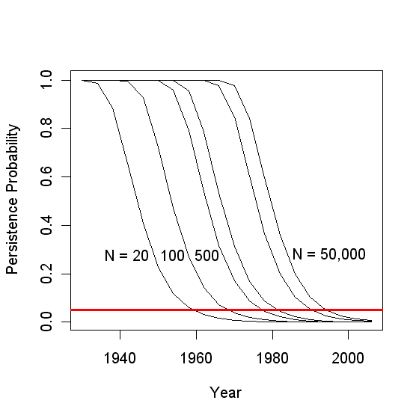

Slide 31
Estimated Extinction Date
1932 Population Size | Estimated Year of Extinction (p < 0.05)
20 | 1961
100 | 1969
500 | 1977
1000 | 1981
5000 | 1993
10,000 | 1997
50,000 | 2005

Slide 32

Contemporary avian census records
from IBW search efforts

Slide 33
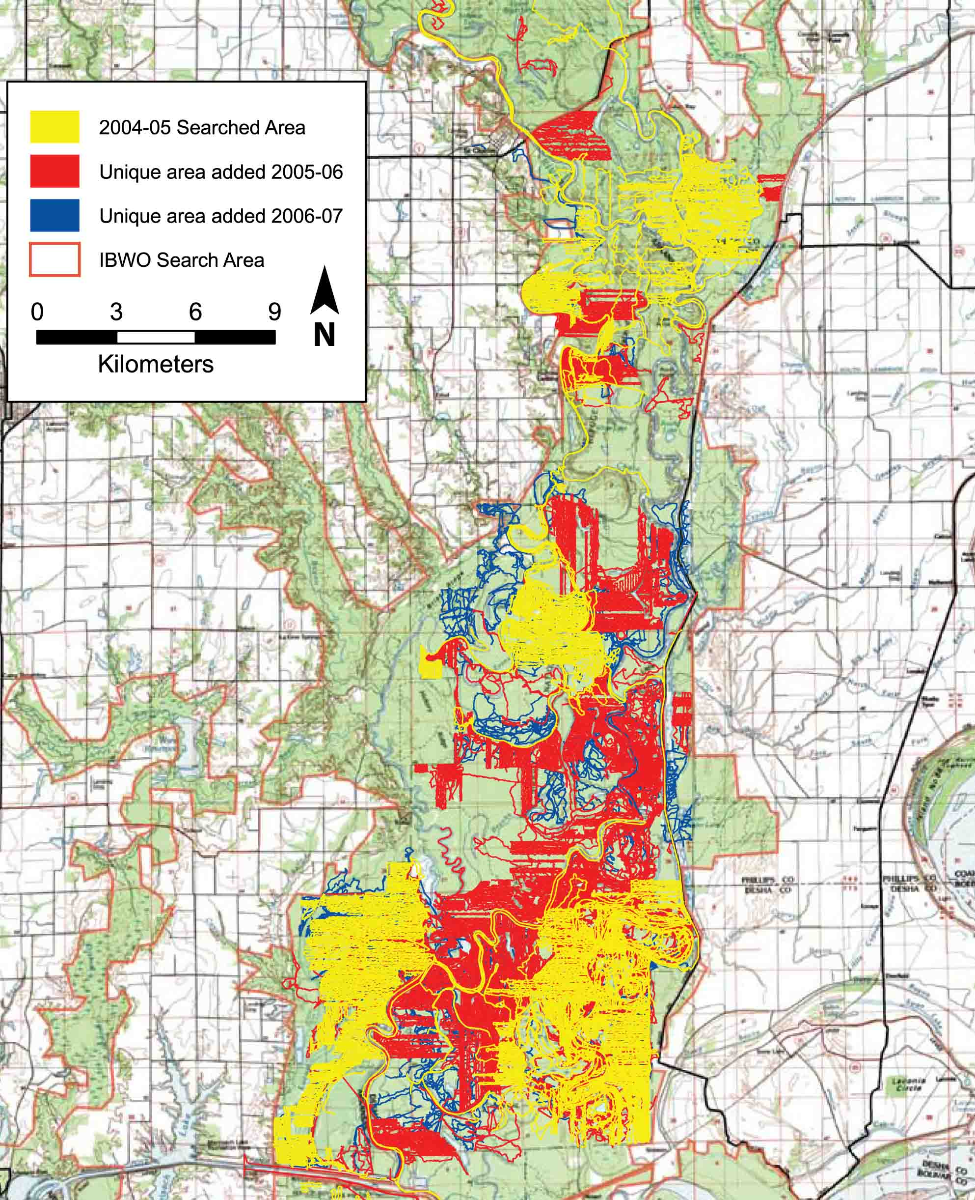

Slide 34
Statistical Inference
Data on the frequencies of rare species in a collection can be used to estimate the number of undetected species
The greater the frequency of “singletons” and “doubletons”, the greater the number of undetected species

Slide 35
Summary of Census Data (2006-2007)
Site | Number of Individuals Censused | Number of Species Recorded | Search Effort (Days)
Congaree River, SC | 15500 | 56 | 26
Choctawhatchee River, FL | 6282 | 55 | 14
Pearl River, LA | 3343 | 54 | 9
Pascagoula River, MS | 6701 | 54 | 9
Four-person search teams on foot, by canoe
Sunrise to sunset searches
Comparable methods at all sites
Records for resident and migratory species that winter in flood plain forest habitats

Slide 36
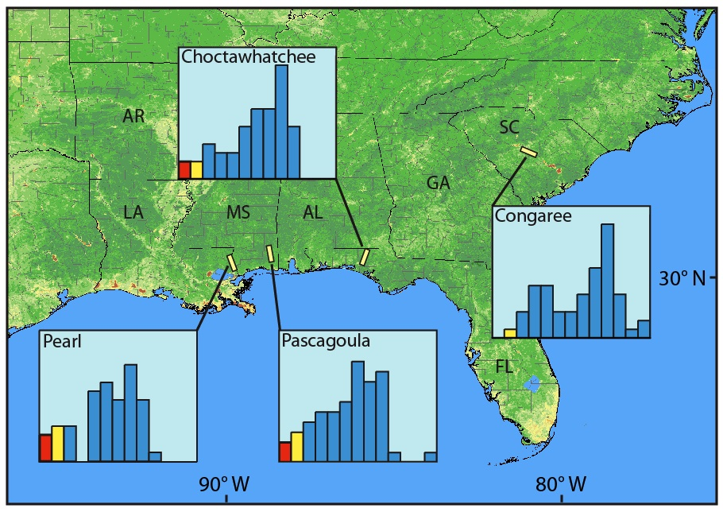

Slide 37
Efficient “Stopping Rule” for terminating searches for undetected species
f(1) = frequency of “singletons” [= number of species represented by exactly one individual
R = expected reward for finding an undetected species (including IBW)
c = cost of censusing one more bird
n = number of individuals censused so far
Abandon search when f(1)/n < c/R
Rasmussen, S. & Starr, N. Optimal and adaptive search for a new species. Journal of American Statistical Association 74, 661–667 (1979).

Slide 38
Efficient “Stopping Rule” for terminating searches for undetected species
f(1) = frequency of “singletons” [= number of species represented by exactly one individual
R = expected reward for finding an undetected species (including IBW)
c = cost of censusing one more bird
n = number of individuals censused so far
Abandon search when f(1)/n < c/R
Because c/R ≈ 0 for IBW, abandon search
when all individuals are represented by at least 2 individuals (i.e. no singletons)
Rasmussen, S. & Starr, N. Optimal and adaptive search for a new species. Journal of American Statistical Association 74, 661–667 (1979).

Slide 39

Estimating Total Number of Species
$$S_{total}=S_{observed}+{{f_{1}}_{}^{2}}/{2f_{2}}$$
f₁ = number of “singletons” (species occurring exactly once)
f₂ = number of “doubletons” (species occurring exactly twice)

Slide 41
f(1) = 0 (no singletons)

Slide 42
Estimates of Undetected Species and Necessary Census Efforts
Site | Number of Individuals Censused | Number of Species Recorded | Undetected Species | Additional censuses required to find undetected species | Probability that next indivdiual censused is a new species
Congaree River, SC | 15500 | 56 | ~0 | - | 8.32 x 10 ⁻⁹
Choctawhatchee River, FL | 6282 | 55 | 1-2 | 6613 | 3.18 x 10⁻⁴
Pearl River, LA | 3343 | 54 | 1-3 | 3061 | 8.97 x 10⁻⁴
Pascagoula River, MS | 6701 | 54 | 1-2 | 4179 | 2.98 x 10⁻⁴

Slide 43
What is the probability that the ivory-billed woodpecker persists today?

Slide 44
What is the probability that the ivory-billed woodpecker persists today?

Slide 45
What is the probability that the ivory-billed woodpecker persists today?

Slide 46
Summary
Specimen-based modeling estimates population decline from museum records
Contemporary surveys estimate the number of undetected species and necessary sampling effort
For IBW, surveys nearly complete
For IBW, 2011 persistence P = 10⁻³ to 10⁻⁵
IBW is now extinct

